Slide 1
8th Spanish Input-Output conference Santiago de Compostela, 2019
Impact Analysis at the City Level: Sensitivity Analysis for Estimating IO Linkages at Different Regional Levels
Kurt Kratena, Eneko Arrizabalaga Uriarte

Slide 2
Framework
Impact analysis (indirect, induced, net effects) of energy technologies at city level with limited information
Combining aggregate and sectoral information at the city level with full SUT at the more aggregate regional level
Calculation of impacts at the aggregate regional level
Estimating a full SUT at city level
or
Breaking down impacts at the aggregate regional level to the city level (FLQ)

Slide 3
The model MIOCIM
V: Supply table (industries * goods). The column sum of this matrix = vector of output by goods, q(g). The row sum = vector of output by industries, q.
U^{d}: Domestic use table (goods * industries). The row sum (including final demand) of this matrix = vector of output by goods, q(g).
U^{im}: Imports use table (goods * industries). The row sum (including final demand) of this matrix = vector of imports by goods, im.
f^{d} and f^{im} : Vectors of final demand, domestic (d) and imported (im) goods (f^{im} is part of im)

Slide 4
The model MIOCIM
From supply table V → Market shares matrix D (dividing by the column sum = the vector of output by goods, q(g)).
D links the output by industries q to the output by goods q(g) : q = D q(g)
From domestic intermediate use table U^{d} → Technical coefficints matrix B^{d} (dividing by the vector of output by industries, q)
The vector f (final demand) consists of private consumption (cp), public consumption (cg), gross fixed capital formation (cf), exports (ex, regional plus to the RoW) and the final demand shock f* (equal to zero in the base year data)

Slide 5
The model MIOCIM
Endogenous private consumption: Balance of primary income → Taxes and transfers → Disposable income → Total private consumption
Primary income: Y = wlq + s_{Y}kq + R, with l and k as vectors of primary inputs per unit of q and R as (production independent) property income. The wage rates w pre-multiply l and the parameter s_{Y} measures the part of operating surplus that enters Y.
Disposable income: YD = [1 – t_{Y} – t_{S}] Y +Tr, with t_{Y} as income tax rate and t_{S} as social security rate, Tr are public transfers
q(g) = B^{d} q + f[1 – im_{f}]
q = D q(g)

Slide 6
The model MIOCIM
Private consumption: Total consumption CP is determined by a linear Keynesian consumption function with mpc (marginal propensity of consumption)
log(CP) = a_{cp} + mpc log(YD)
The user choses mpc between 0 and 1.
The vector of domestic private consumption cp^{d} is determined by multiplying the vector of budget shares of domestic goods in CP (w^{d}_{cp}) with CP: cp^{d} = w^{d}_{cp}CP
The other final demand categories remain exogenous, f_{ex}.

Slide 7
The model MIOCIM
Public sector: Tax rates t_{Y} and t_{S} are exogenous → Taxe revenues are endogenous. Transfers Tr and public consumption cg are exogenous.
Net effects: part of the total shock i’f* (0 < s_{p} >1) is publicly financed and compensated by a reduction in Tr and/or total public consumption, i’cg (with i’ as transposed unity vector for summation): s_{p} i’f* = -Δi’cg - ΔTr
The user decides the composition of -Δi’cg vs. - ΔTr

Slide 8
The model loops
Indirect effects (Leontief model):
q(g) = B^{d} q + f(1 – im_{f})
q = D q(g)
f = cp + cg + cf + ex + f*
Induced effects (SAM multiplier model):
q(g) = B^{d} q + cp^{d} + f_{ex}(1 – im_{f})
q = D q(g)
f_{ex} = cg + cf + ex + f*
cp^{d} = w^{d}_{cp}CP
CP = exp (a_{cp} + mpc log(YD))
YD = [1 – t_{Y} – t_{S}] Y +Tr
Y = wlq + s_{Y}kq + R

Slide 9
The model loops
Net effects (SAM multiplier plus macroeconomic closure):
q(g) = B^{d} q + cp^{d} + f_{ex}(1 – im_{f})
q = D q(g)
f_{ex} = cg + cf + ex + f*
cp^{d} = w^{d}_{cp}CP
CP = exp (a_{cp} + mpc log(YD))
YD = [1 – t_{Y} – t_{S}] Y +Tr
Y = wlq + s_{Y}kq + R
i’f* = - ΔTr

Slide 10
Data
SUT for Basque Country 2016: 88 industries and 105 goods → aggregation to MIOCIM (64 * 64), Supply and Use table in basic prices for domestic inputs and imports, value added and final demand categories
Data for Bilbao: value added and employment by 64 MIOCIM industries, population, disposable income (renta personal) and the components

Slide 11
CHARM method
Estimating final demand for Bilbao (2016):
Private consumption: YD/population (Basque country, Bilbao) & income elasticity for goods
Public consumption: output by public industries & cg(i)/population (Basque country)
Gross fixed capital formation by industry: cf(j)/q(j) (Basque country) & capital formation matrix, industries*goods (Spain)
Applying Basque country technology for Bilbao:
Net output ratio va(j)/q(j) for Basque country & q(j) for Bilbao

Slide 12
CHARM method
Applying Basque country technology for Bilbao:
Product mix matrix C for Basque country to convert output by industries q to output by goods : q(g) = C q for Bilbao
Use structure matrix S for Basque country to calculate x(ij) by column for given x(j) = q(j) – va(j)
Domestic supply q(g) minus demand [f + B q] → trade balance b = ex – im. Trade volume v = ex + im.
Calculating cross hauling measure by industry: (v(i) + [b(i)])/(q(i) + x(ij) + f(i))

Slide 13
CHARM method
Income elasticity for consumption goods:

Slide 14
CHARM method
Income elasticity for consumption goods:

Slide 15
SUT for Bilbao
(v(i) + [b(i)])/(q(i) + x(ij) + f(i)) (Basque country), manufacturing industries:

Slide 16
SUT for Bilbao
(v(i) + [b(i)])/(q(i) + x(ij) + f(i)) (Basque country), service industries:

Slide 17
SUT for Bilbao
Significantly higher import shares in the Bilbao SUT for manufacturing industries

Slide 18
SUT for Bilbao
Significantly lower import shares in the Bilbao SUT for service industries

Slide 19
FLQ method
Multiplying the Basque country (National, N) technical coefficients b^{d}(ij) by Flegg‘s LQ (location quotient):
b^{d,N}(ij) ; if FLQ(ij) > 1
b^{d,R}(ij) =
b^{d,R}(ij) = FLQ(ij)b^{d,N}(ij); if FLQ(ij) > 1
where FLQ(ij) =CILQ(ij). λ*
λ* = [log₂(1 + Q^{R}/Q^{N})]^{δ} with δ = 0.1
CILQ(ij) = SLQ(i)/SLQ(j)
The simple location quotient SLQ is defined as SLQ(i) = (q^{R}(i)/Q^{R})/(q^{N}(i)/Q^{N}) and measures relative regional specialization in output.

Slide 20
FLQ for Bilbao
Significantly lower domestic inputs (sum of B(d) matrix) in FLQ method

Slide 21
Technology scenario
Case study: The scenario evaluated considers the potential deployment of 3 interventions designed for the city of Bilbao
Solar thermal systems for residential buildings (34.000 m² with a cost of 437 €/m²)
Solar photovoltaic systems for residential and tertiary buildings (250.000 m² with a cost of 278.9 €/m² )
A small district heating system fired with biomass and natural gas boilers (covering a demand of 5.2GWh with a cost of 250 €/kW for the biomass central heating boilers and 54 €/kW for the natural gas-fired boilers)

Slide 22
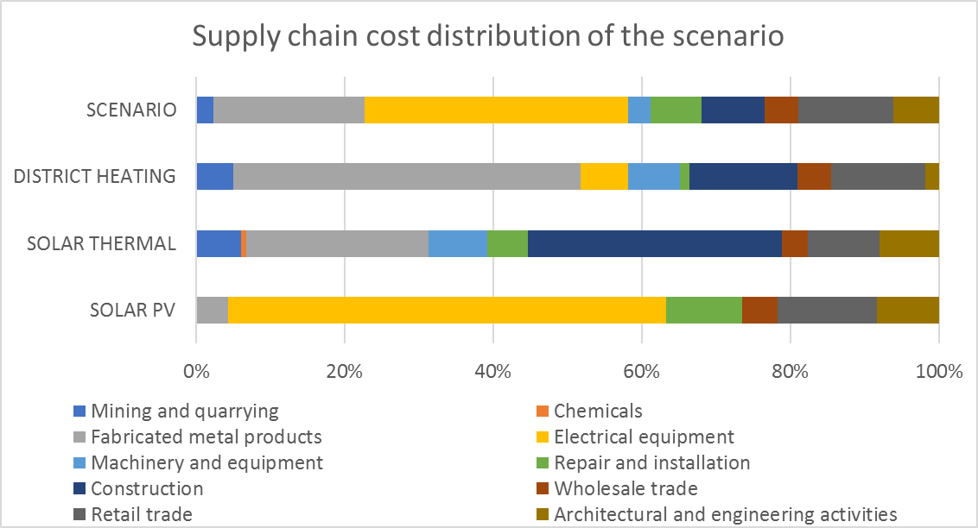
Technology scenario
The shock considers the supply chain (CAPEX) cost distribution of each technology by their main components

Slide 23
Technology scenario
Macroeconomic impacts, Model Basque Country
Macroeconomic impacts, Model Bilbao
Small differences in aggregate results for the 3 types of impacts

Slide 24
Technology scenario
Gross output impacts, Model Basque Country
Gross output impacts, Model Bilbao

Slide 25
Technology scenario
Gross output impacts & induced effects: significant differences for industries affected by IO and consumption/income linkages

Slide 26
Technology scenario
Gross output impacts & net effects: significant differences for industries affected by consumption/income linkages

Slide 27
Technology scenario
Gross output impacts & induced effects: significant differences in manufacturing industries, lower effects in the Bilbao-model

Slide 28
Technology scenario
Gross output impacts & net effects: significant lower effects in the Bilbao-model

Slide 29
Technology scenario
Gross output impacts & indirect effects: higher impact (IO and consumption/income linkages) in the Bilbao-model, compared to FLQ

Slide 30
Conclusions
The CHARM method yields a SUT for the disaggregate regional level with differences in import shares in both directions and similar total domestic input coefficients by industry
The FLQ method yields significantly lower total domestic input coefficients by industry
Impacts from the Bilbao/SUT-model are lower than from the Basque country/SUT-model; impacts from the FLQ method are lower than from the Bilbao/SUT-model
Is cross hauling a property of goods or of goods & regions?
Is the FLQ method biased towards low domestic input coefficients?

